Slide 1

Is Tesla Equity Outperforming the Market for the next 5, 10 and 15 Years?

Slide 2
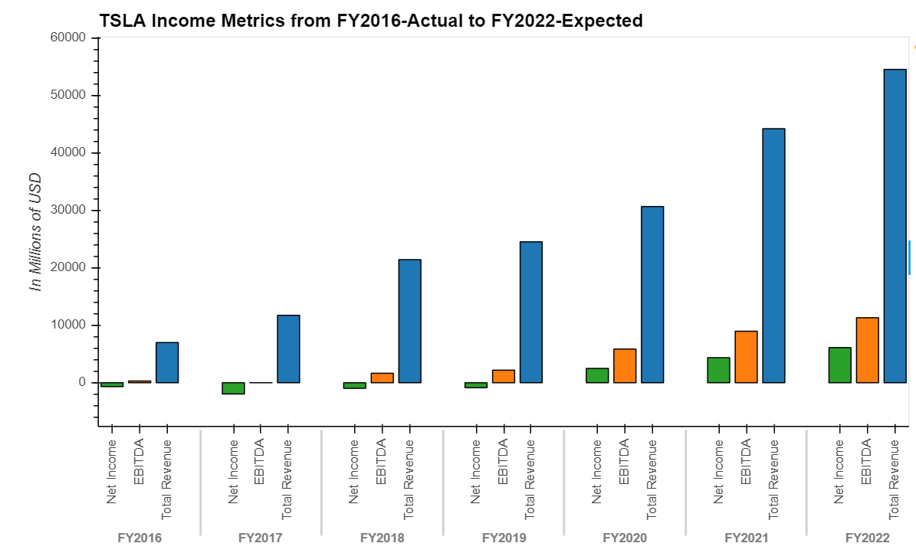
TSLA-Financial Analysis
Income Metrics- Net Income, EBITDA, Revenue
Profitability
Revenue CAGR 36.89% from FY2016 to 2019
EBITDA CAGR 64.12% from FY2016 to 2019
Net Income has turned positive in FY2020
Capex growth trend with cumulative 12 months YoY of 94.62% to $ 2,423 as of Sep 30 2020
Average Capex from FY2016 to 2020 LTM is $2237.4 M
Revenue CAGR 36.89%
EBITDA CAGR 64.12%
2
Source ：FactSet, Equity Research Report, FS. Note 1, adjusted EBITDA = EBITDA excludes share based payments
Notes:
(1,634.9) (1,440.5) (4,081.0) (2,319.0) (1,432.0)

Slide 3
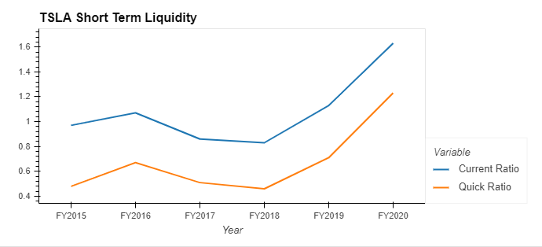
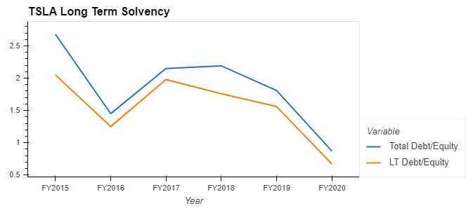
TSLA-Financial Analysis
Short-term Liquidity Analysis
Long-term Solvency
The quick ratio offers a more conservative view of a company’s liquidity or ability to meet its short-term liabilities with its short-term assets
Description to be added
3
Source ：FactSet, Equity Research Report, FS

Slide 4
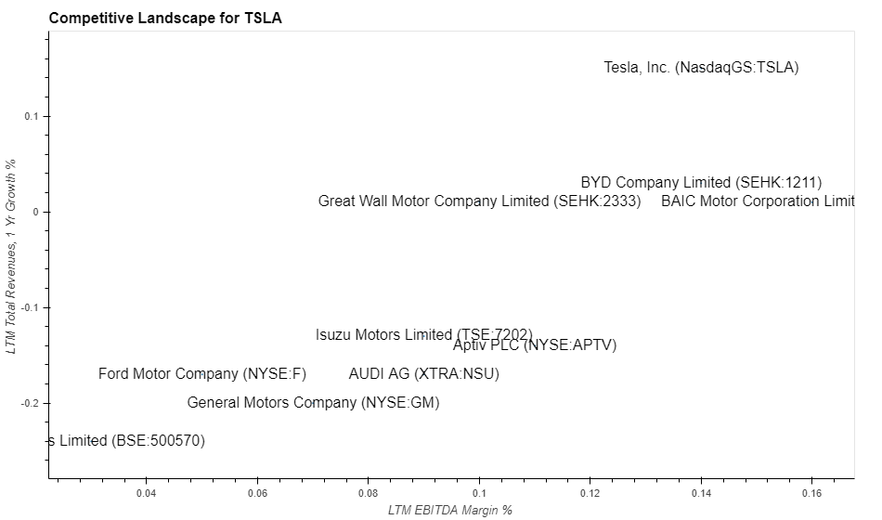
TSLA- Competitive Landscape
First Tier Company - TSLA
Selected Competitors
General Motors Company
Ford Motor Company
BAIC Motor Corporation
Aptiv PLC
BYD Company
Great Wall Motor Company
Isuzu Motors
AUDI AG
Tata Motors
Highlights
TSLA has EBITDA margin around 14% and revenue YoY of 15%, serving as an industry leader
Compared to industry median of 9.5% EBITDA Margin and -13.5% 1-year Revenues Growth, TSLA becomes competitive and first tier candidate
4
Notes:
General Motors Company
Ford Motor Company
BAIC Motor Corporation Limited
Aptiv PLC
BYD Company Limited
Great Wall Motor Company Limited
Isuzu Motors Limited
AUDI AG
Tata Motors Limited
LTM EBITDA Margin % 0.095 LTM Total Revenues, 1 Yr Growth % -0.135

Slide 5
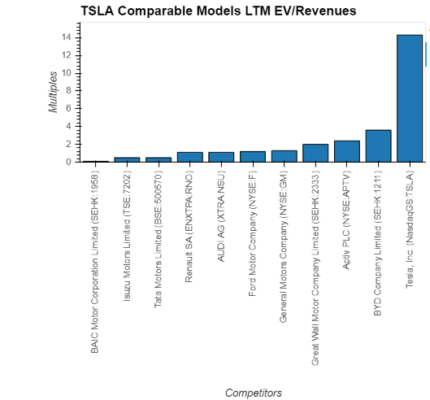
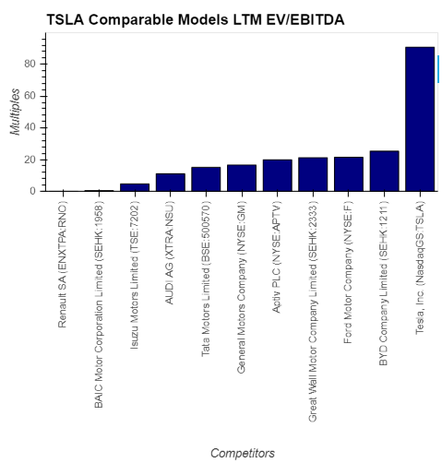
TSLA-Comparable Models
Valuation Highlights - EV/Revenues LTM is 14.3x
Valuation Highlights - EV/EBITDA LTM is 90.8x
Industry Median:1.2x
Industry Median:16.6x
5
Source ：FactSet, Equity Research Report, FS
Notes:
TEV/Total Revenues LTM – Latest 14.3
TEV/EBITDA LTM – Latest 90.8
Industry 50th percentile
TEV/Total Revenues LTM - Latest 1.2 TEV/EBITDA LTM - Latest 16.6

Slide 6
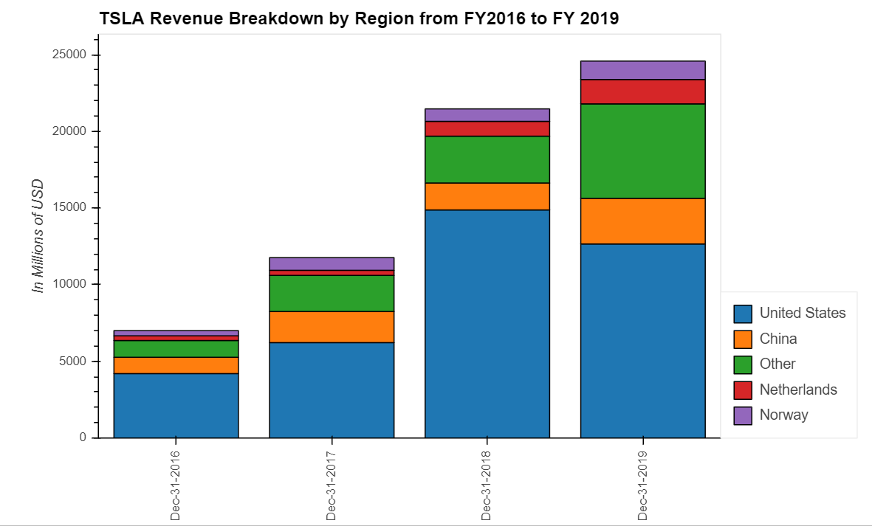
TSLA-Financial Analysis (Prob don’t need this page)
Revenue breakdown by region
6
Source ：FactSet, Equity Research Report, FS. Note 1, adjusted EBITDA = EBITDA excludes share based payments

